Slide 1


Author: Doris Amoakohene Supervisor: Toby Hocking Co-Worker: Anirban Chetia
Outline of Presentation
Introduction
Visualizing the atime result of various functions with data.table
Visualizing the atime result for performance regression
GitHub Action
Conclusion
1
2
3
4
Title: Benchmarking Performance for the data.table Package
5

Slide 2


1: Introduction
Comparative Benchmarking: Comparing data.table to other packages in R and python that perform similar tasks
data.table
VRS
pandas
data.table
VRS
Other R packages
Performance Testing: We evaluate the performance of different versions of the data.table package by benchmarking their memory and time usage.
fast
commit
slow
fixed
fast

Slide 3
1: Introduction
Comparative Benchmarking: Comparing data.table to other packages in R and python that perform similar tasks
data.table
VRS
pandas
data.table
VRS
Other R packages
Performance Testing: We evaluate the performance of different versions of the data.table package by benchmarking their memory and time usage.
fast
commit
slow
fixed
fast

Slide 4
1: Introduction - Benchmarking Methods
 | project | N (data size) /Visualizing result | GitHub action | Visualizing of result
airspeed velocity | python | Single N value/NO | Print result on a webpage | No
Conbench | arrow | Single N value/NO | - | No
Touchstone | R | Single N value/NO | Comment in GitHub Pull Requests. | No
pytest-benchmark | Python projects with pytest | Single N value/NO | Benchmark results are visualized on the GitHub pages of your project. | No
atime(proposed, not only for data.table but other packages as well) | data.table and other R packages | Sequence of N values/ YES | Comments the generated results on pull requests. | Yes

Slide 5
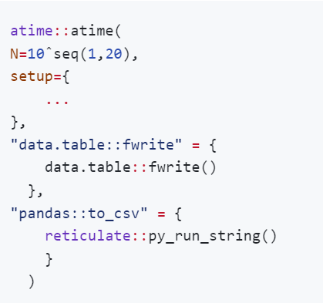
2. Visualizing the atime result of various functions with data.table
atime::atime function for comparative benchmarking
data size to vary over
expression to evaluate for every data size, before timings.
named list of expressions to time.

Slide 6
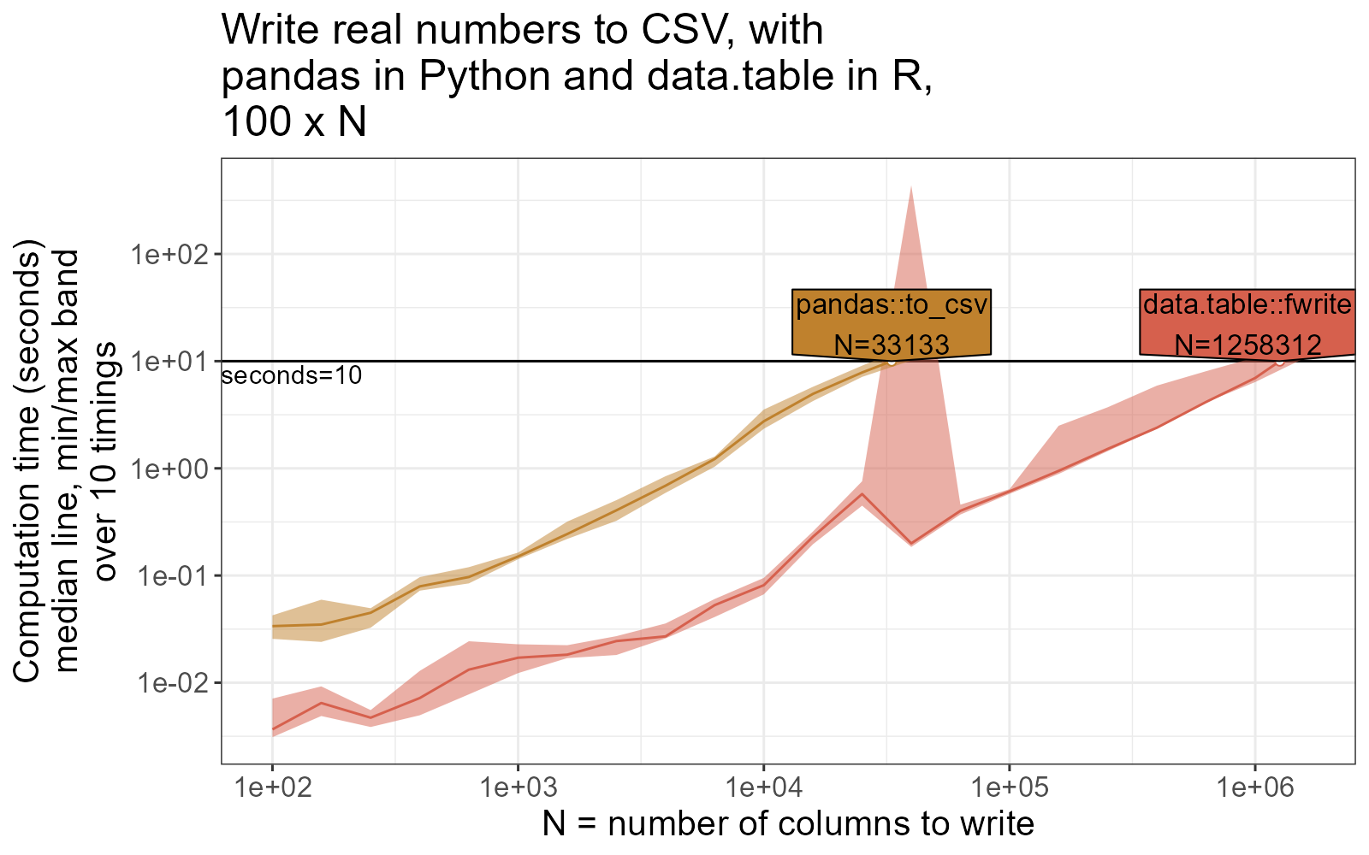
2. Visualizing the atime result of various functions with data.table

Slide 7
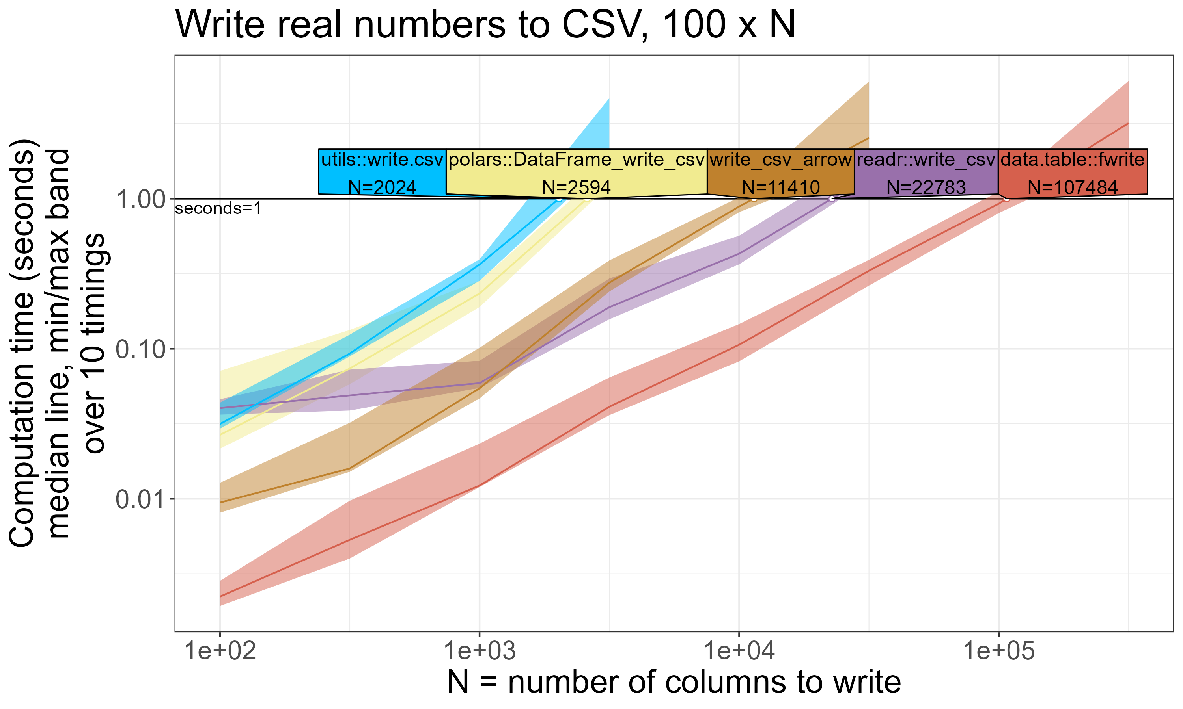
2: Comparative Benchmarking Results

Slide 8
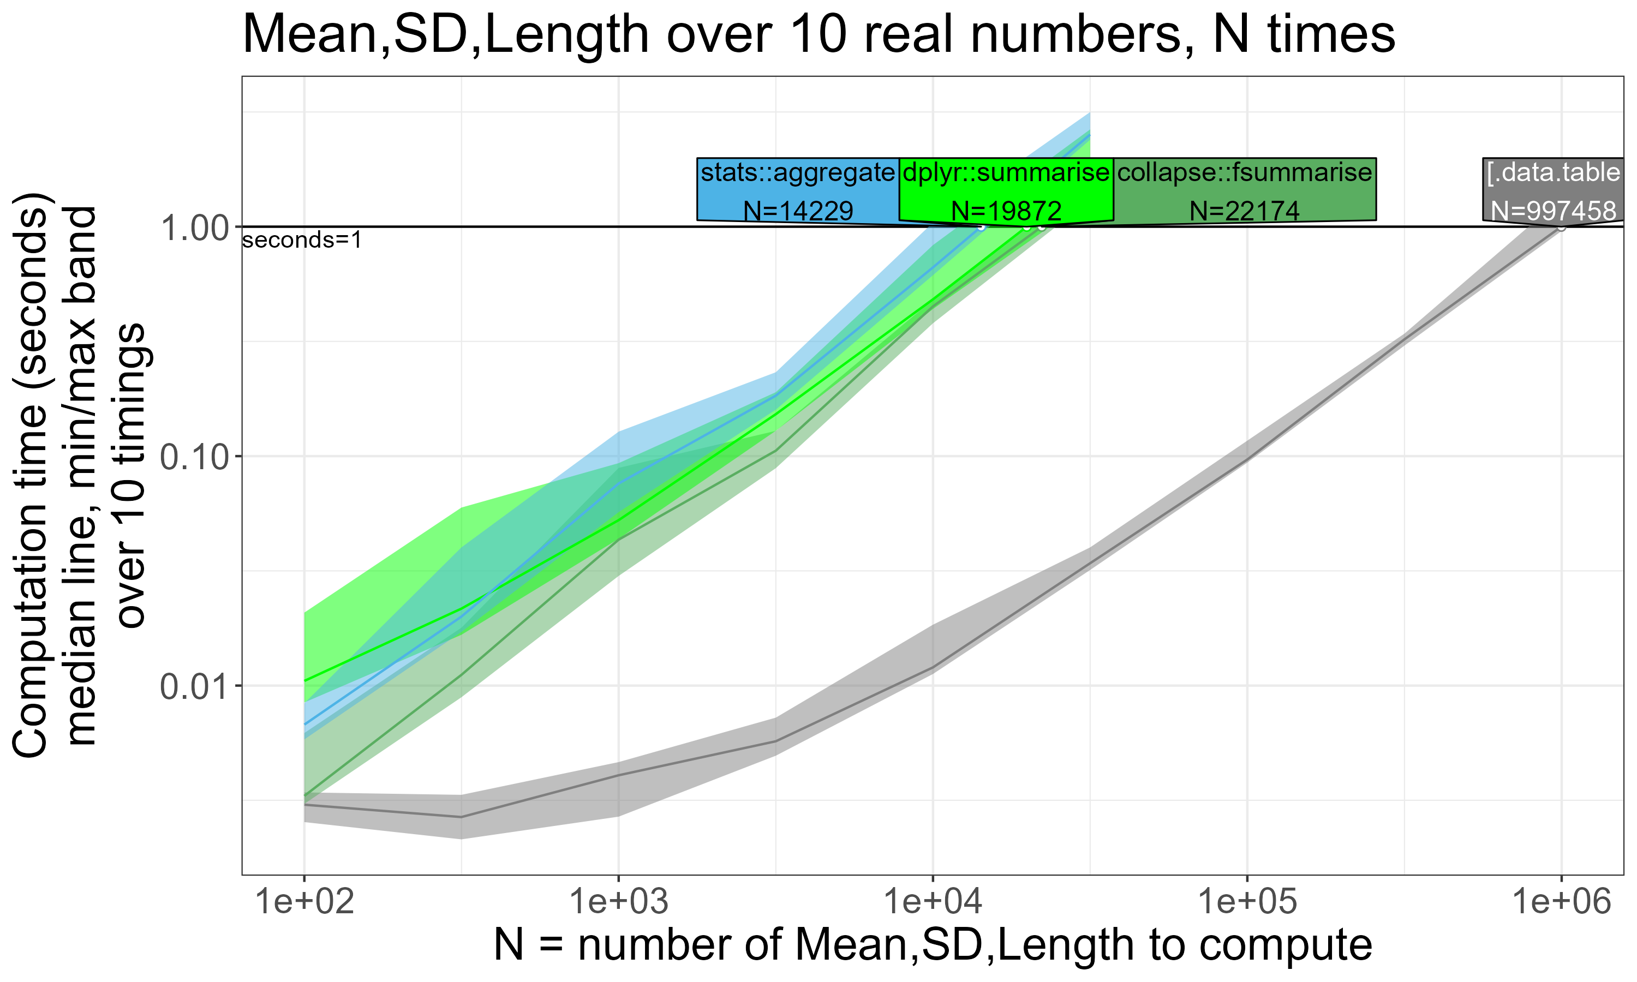
2: Comparative Benchmarking Results

Slide 9
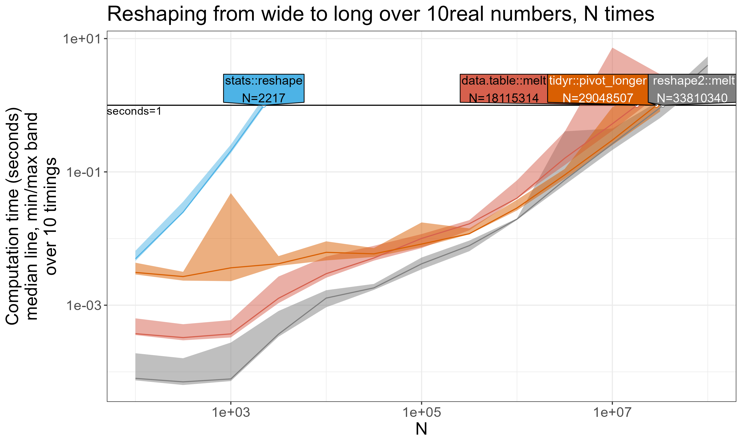
2: Comparative Benchmarking Results

Slide 10
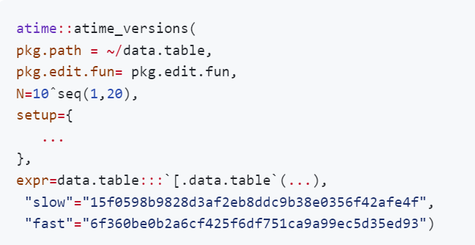
3. Visualizing the atime result for performance regression
atime_versions, atime function for performance testing over different version of an R package
Path to git clone of repo containing R package(data.table).
function called to edit package before installation

Slide 11
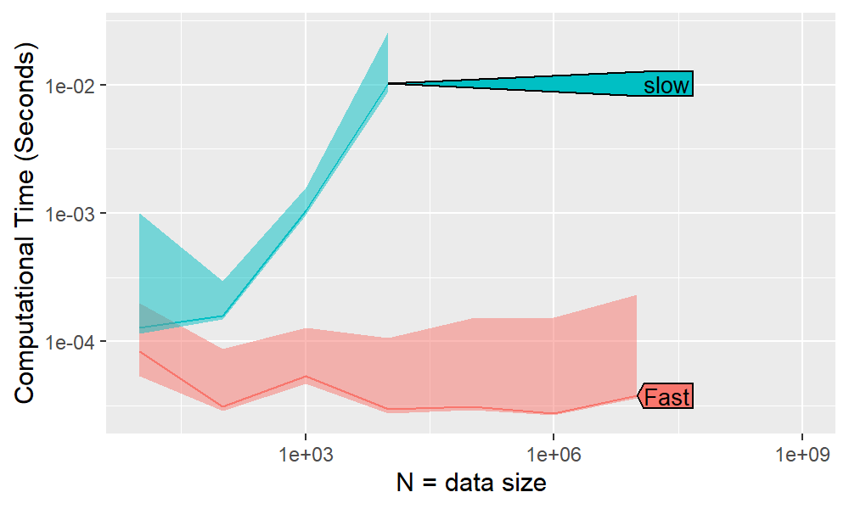
3: Performance Testing Result

Slide 12
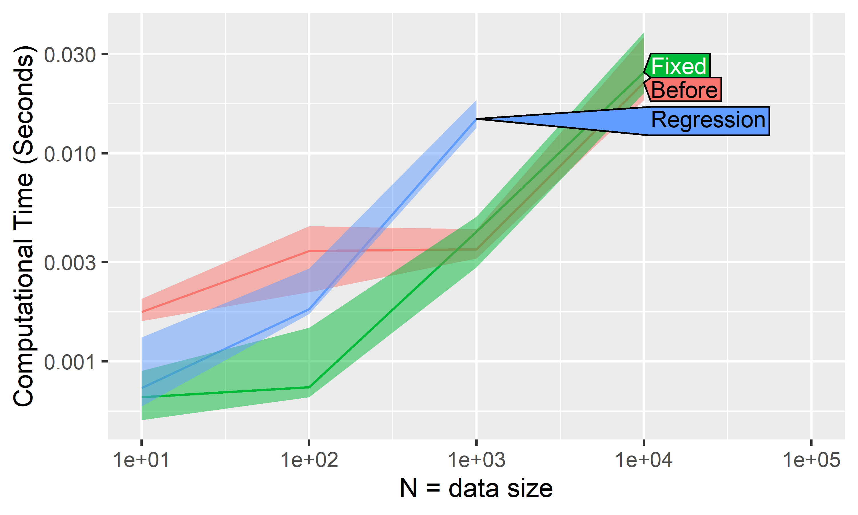
3: Performance Testing Result

Slide 13
3: GitHub Action
A GitHub Action is an automated workflow that can be set up in a GitHub repository to perform various tasks such as building, testing, and deploying software
It helps to identify and address any performance issues, ensuring that the package is performing well.
Our GitHub Action for R packages runs atime::atime_pkg and comments the generated results on pull requests to help identify potential performance regressions introduced from the incoming changes.

Slide 14
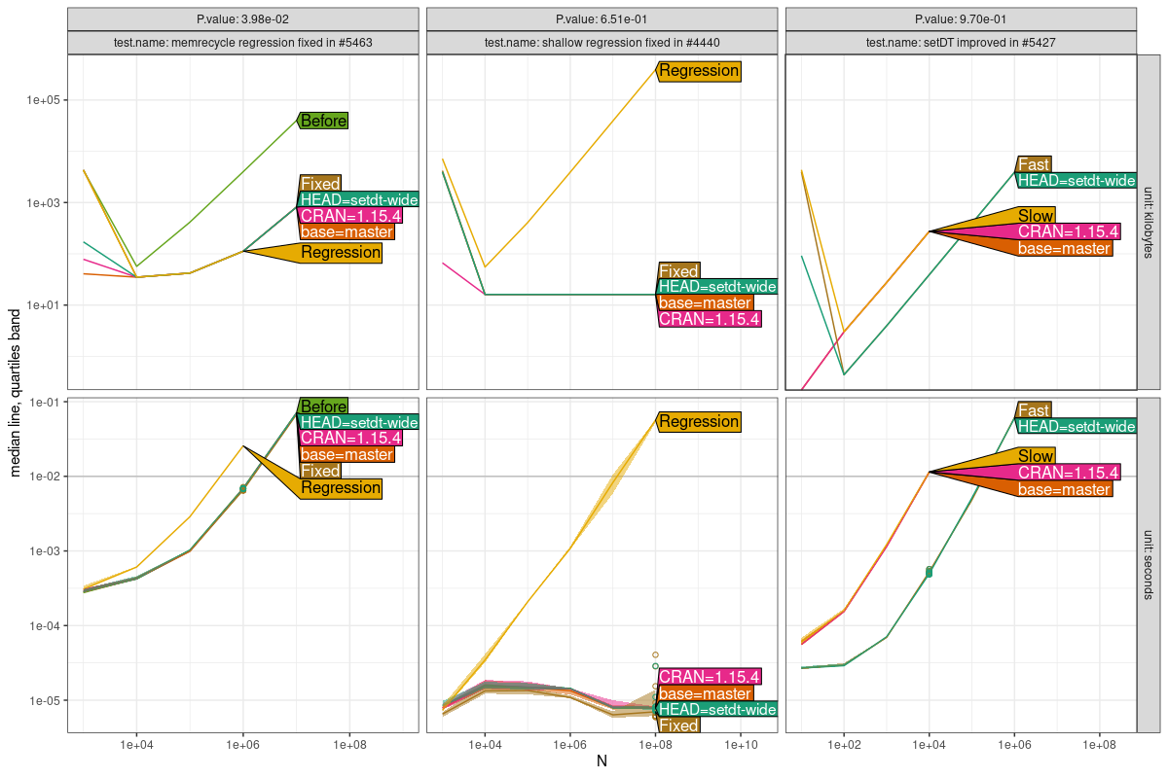
3: GitHub Action

Slide 15

data.table is an efficient package for data manipulation.
atime package proves to be exceptionally useful for conducting comparative benchmarking and performance testing.
5: Conclusion

Slide 16
3: GitHub Action
MERGE BASE: the common starting point when combining different branches in version control systems like Git.
HEAD: points to the latest changes in a version control system, showing the current state of a project.
FAST: indicating the version that fixed the regression and executes quickly.
SLOW: version with the regression and takes a longer time to execute.
CRAN: The collection of servers that store R packages.
BASE: basic package in R that provides important functions and structures.

